Slide 1

2018 Conservation Tillage Weed Management
Stanley Culpepper
UGA Extension
Tifton, GA

Slide 2
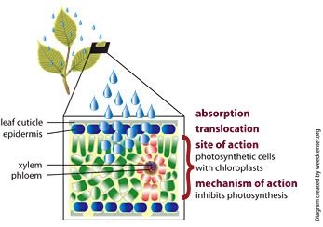

Reality of Weed Control
Last new herbicide chemistry
over 30 years ago.
2. New chemistry – not likely.
3. Don’t get confused, may have new “tools” but not new chemistry.

Slide 3

Reality of Weed Control
EPA - resistance mgmt plan.
More policy/politics expected.
More resistance is guaranteed!
Loss of very effective herbicides are occurring each year especially in Palmer amaranth and ryegrass.

Slide 4
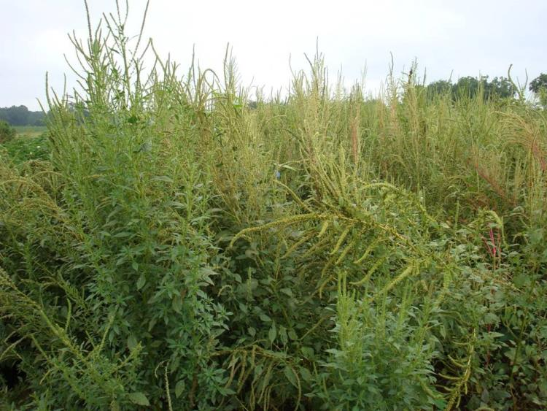
Palmer–Resistant Classes of Chemistry
ALS inhibitors – Staple, Cadre
EPSPS - Roundup
PSII – Atrazine
DNA – Treflan
HPPD – Laudis
PPO – Reflex, Valor

Slide 5
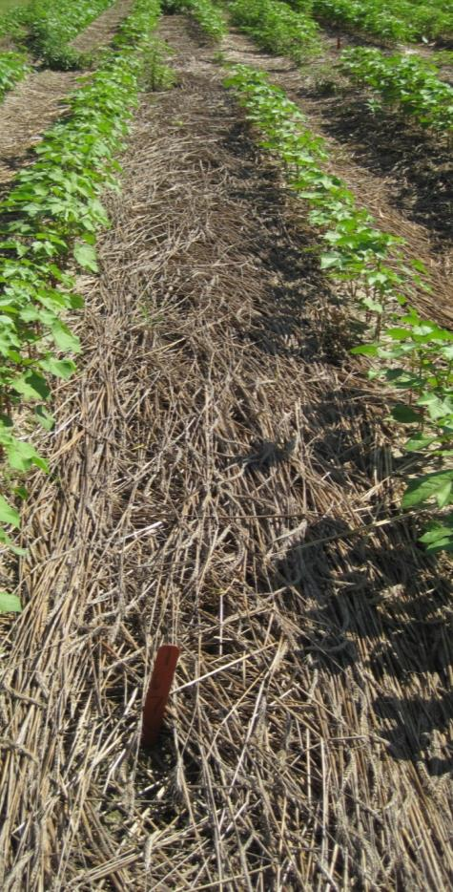
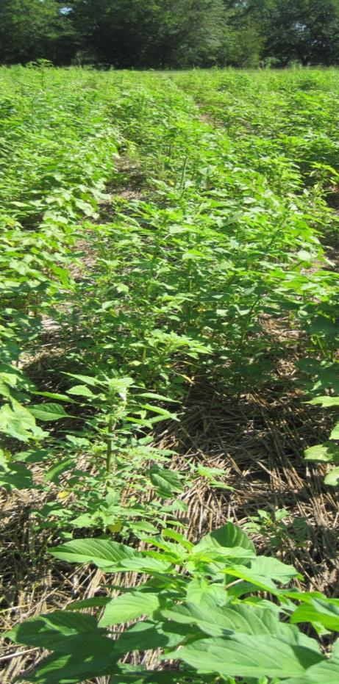
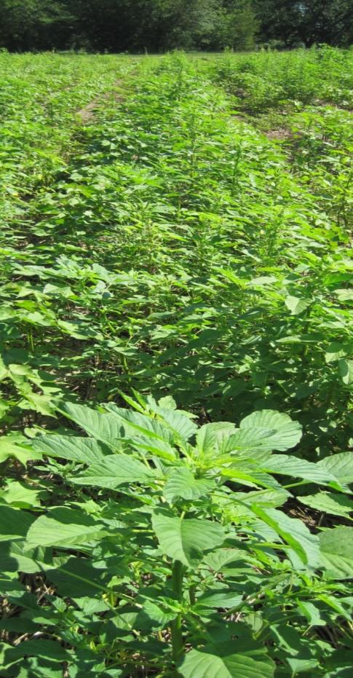
Level and Stability of Biomass is Important
7000 lb/A
3000 lb/A
2000 lb/A
dry weight

Slide 6
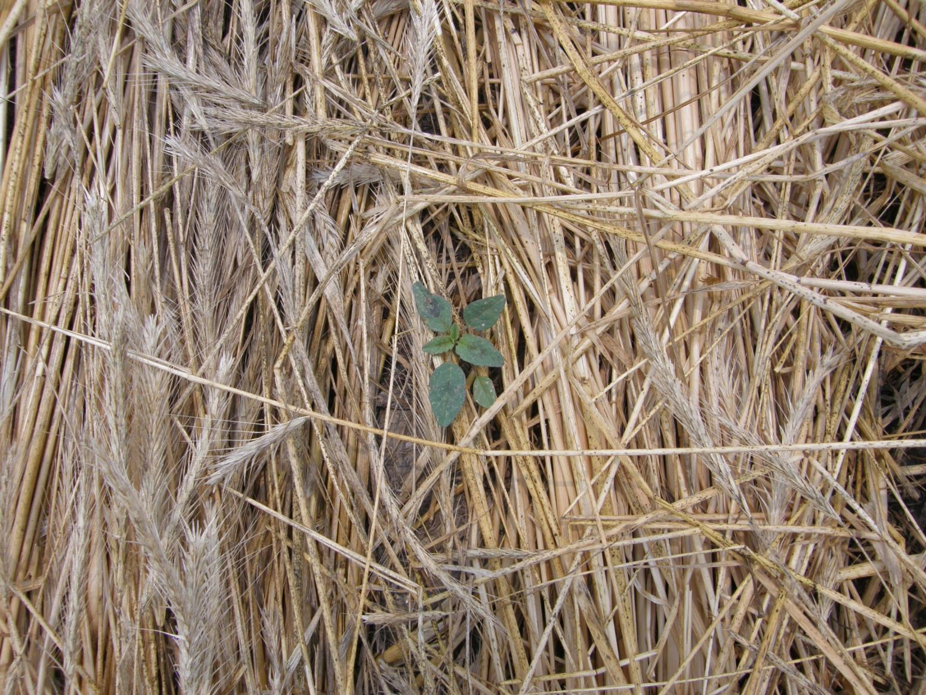
Palmer Will Exploit Any “Holes” in the Rye

Slide 7
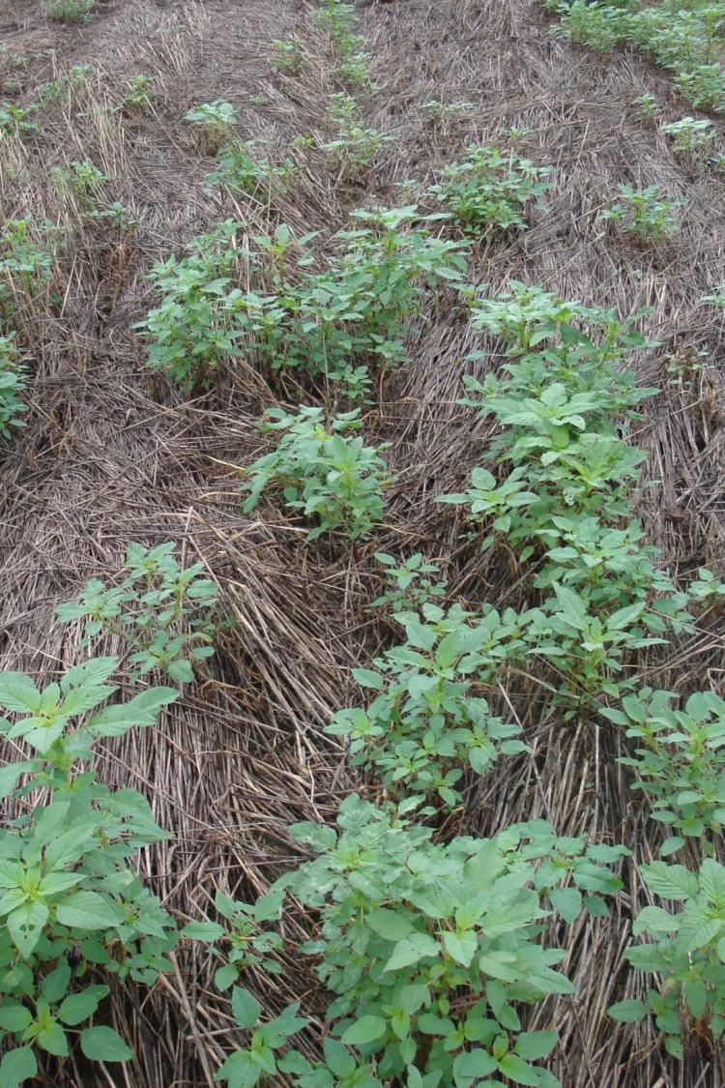
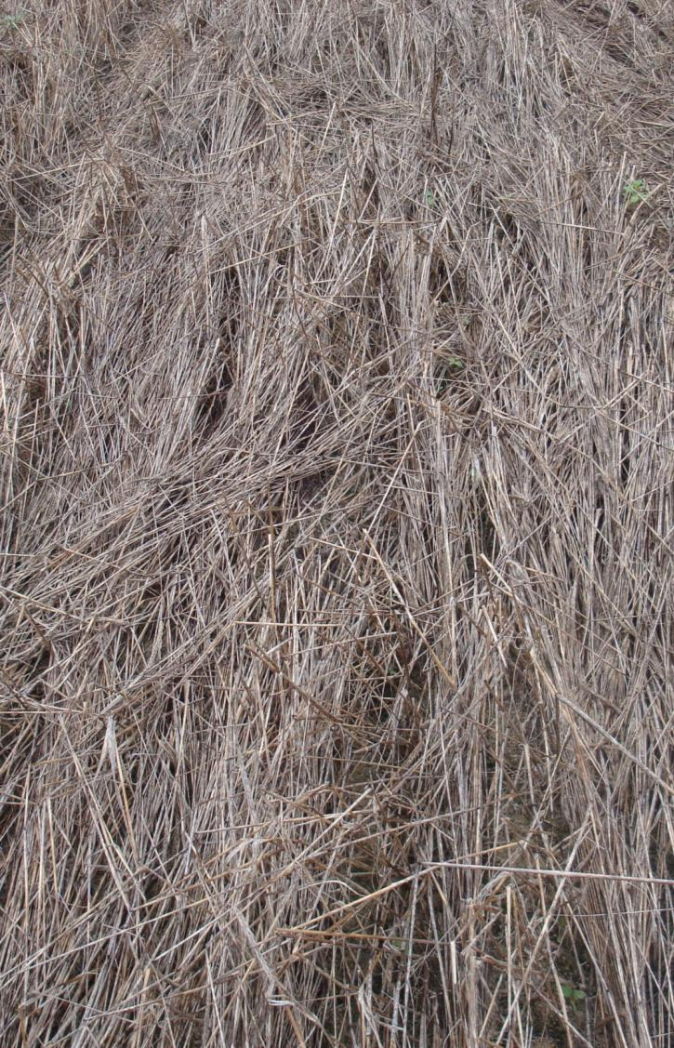
No herbicide
Herbicide

Slide 8
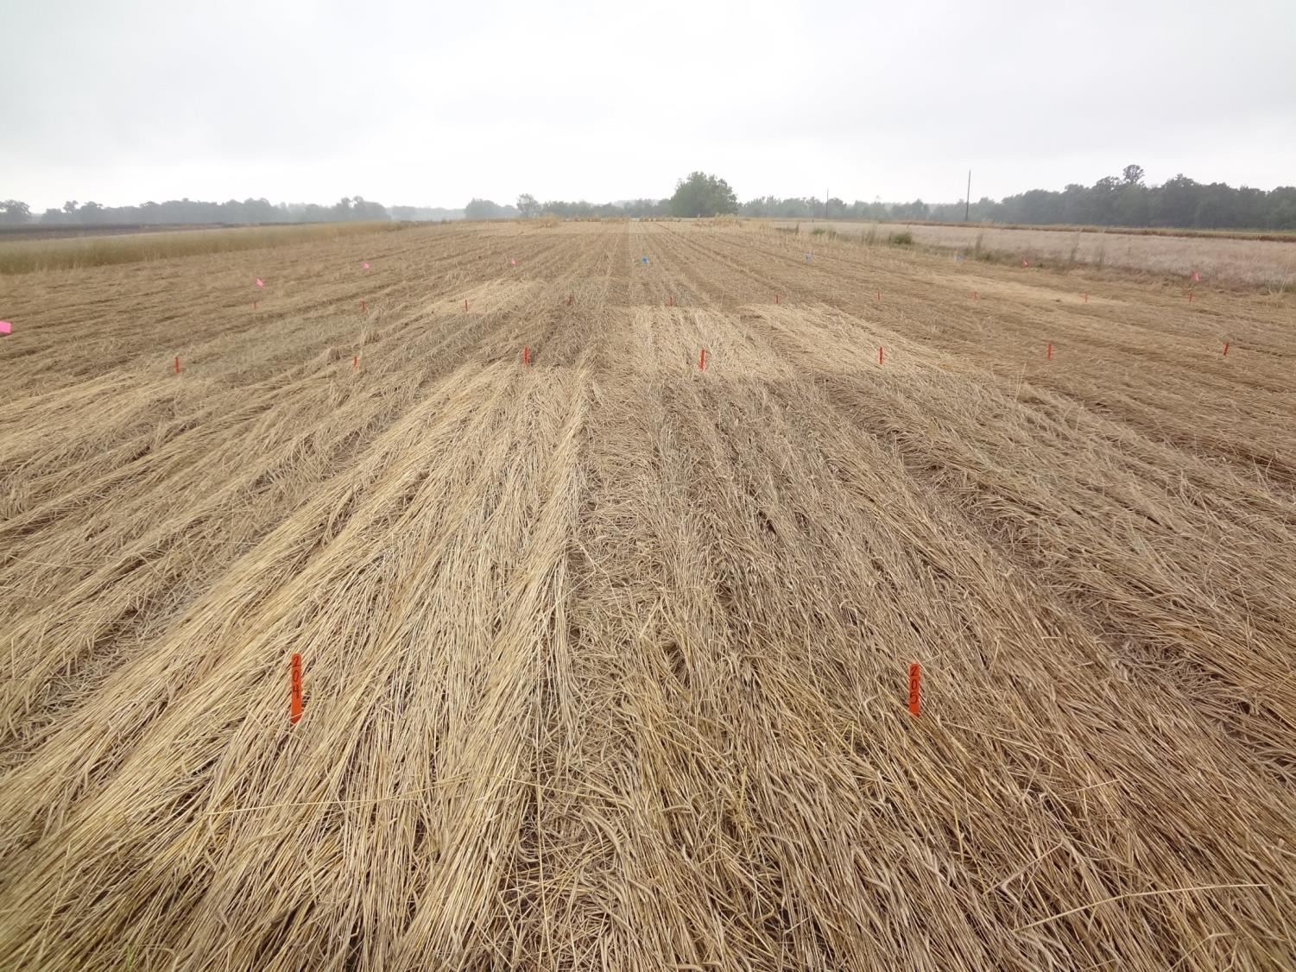
After Cover is Terminated and it Rains; Planting will be Ideal for a Significant Amount of Time

Slide 9
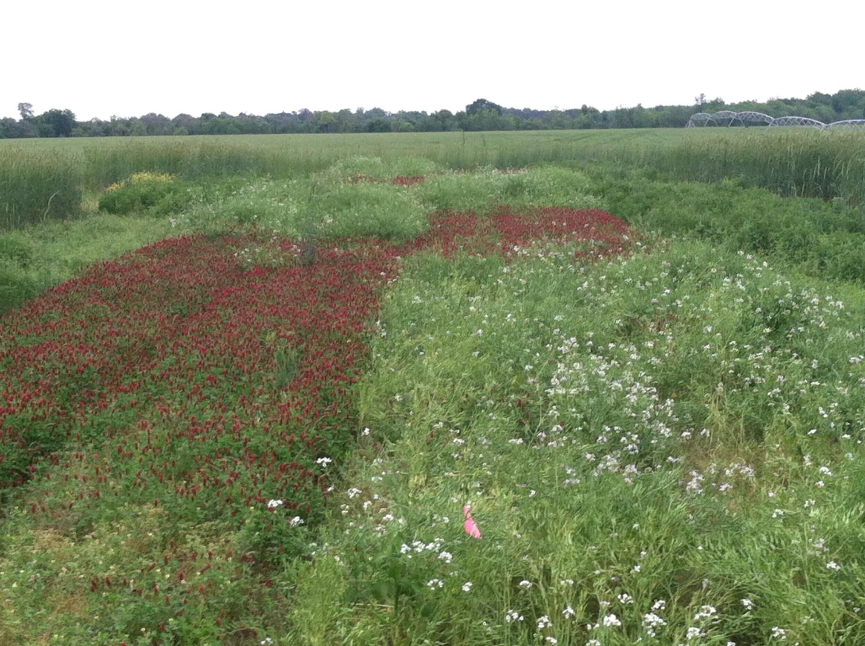
Many Cover Crop Options – Termination Tactics Differ.

Slide 10
Cover Crop Termination – Grains
Rye, oats, wheat, triticale, black oats
ROUNDUP
Gramoxone
Stage of Growth
Temp
(nighttime)
Rate/Tank Mixtures

Slide 11
Cover Crop Termination –Grains
Stage of Growth
Jointing through boot often more difficult but varies by crop planted
Temp
(nighttime)
Varies by crop – metabolic processes in plant slow making Roundup slower and often less effective
Antagonism from tank mixtures is common, rate can often be used to overcome issues or sequential applic
Rate/Tank Mixtures

Slide 12
Wheat Response to Roundup Mixes Just Prior to Boot Stage of Growth. Mar 2018.
98 a
99 a
89 b
84 bc
RU
RU + Liberty
RU + Valor
RU + Valor + Direx
RU PMAX 32 OZ/A; Liberty 32 oz/A; Valor 2 oz/A, Direx 1 pt/A

Slide 13
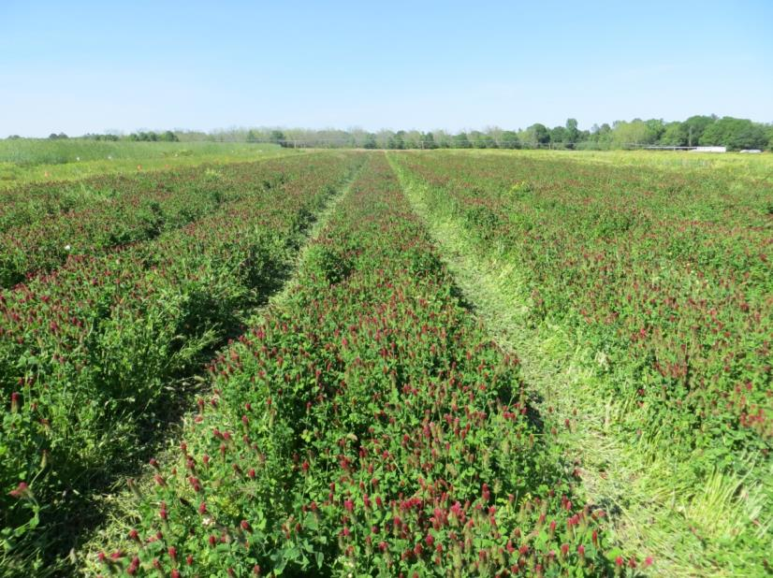
Cover Crop Termination –Clover
Difficult to control?
Maturity influences response: Prebloom vs PostBloom?

Slide 14
Controlling Clover with Burndown Herbicides. Mar 2018.
92 b
100 a
78 c
60 d
RU
RU + Engenia
Liberty
Gramoxone
+ Direx
RU PMAX 32 OZ/A; Liberty 32 oz/A; Valor 2 oz/A, Direx 1 qt/A; Gramoxone 1 qt/A; Engenia 9.5 oz/A.

Slide 15
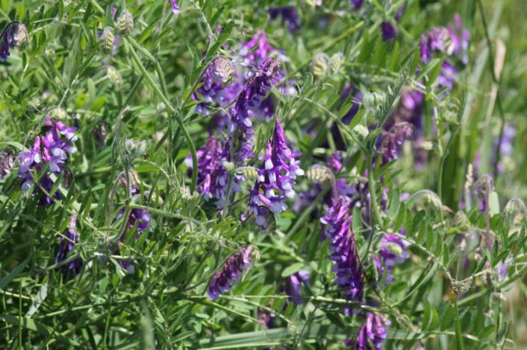
Cover Crop Termination – Vetch
Roundup + dicamba or Roundup + 2,4-D
After Seed Set:
Gramoxone + diuron (cotton)

Slide 16
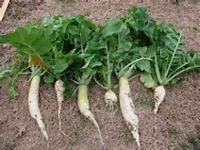
Tillage Radish…scary to the weed guy
1) Resistance.
Allelochemical effect???
Mixtures with 2,4-D or dicamba should be effective

Slide 17
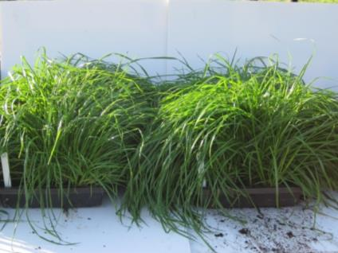
Ryegrass–Resistant Classes of Chemistry
Accase inhibitors – Poast, Select, Axial, etc
ALS inhibitors – PowerFlex, Osprey, Beyond
EPSPS - Roundup
Long Chain Fatty – Dual/Warrants
Glufosinate amm. - Liberty
PS I – Electron - Gramoxone

Slide 18
Managing Ryegrass
If applying same chemistry 3 years in a row, resistant plants will likely be observed by 3 years.
Roundup better than Gramoxone (unless plant fully mature).
Best herbicide approach is to
apply Roundup and follow with
Gramoxone 5-7 days later.

Slide 19
Burndown: 2,4-D vs Dicamba When Mixed with Roundup
Horseweed
Primrose
Radish
Cost
Plantback
2,4-D
+
++
++
++
+ 2,4-D
dicamba
++
+
+
+
+ dicamba

Slide 20

Notes:
For clover, we seed it following the same process. Here is an example of a sister study, determing the most effective herbicide approach to control clover as that is difficult at times.

Slide 21
Gaps >1 Foot As Influenced by Production Practice. 2016 Expo.
Plots 18 feet by 450
88 a
1 b
0 b
Conventional
Clover
Rye
1 month after planting
Conventional = rip/bed no cover; Clover 12 lb/A = 7700 lb dry biomass; Rye 90 lb/A = 9970. Study maintained weed free with timely herbicide program

Slide 22
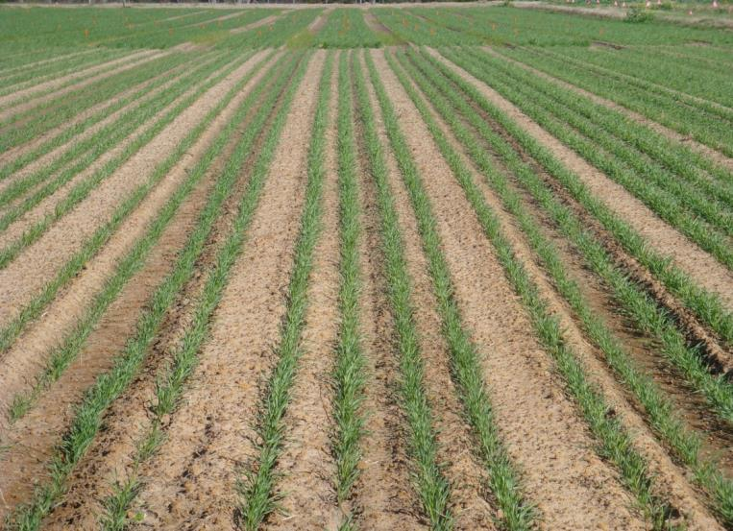
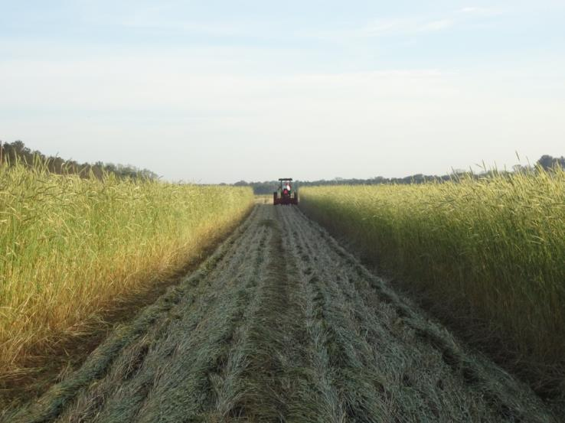
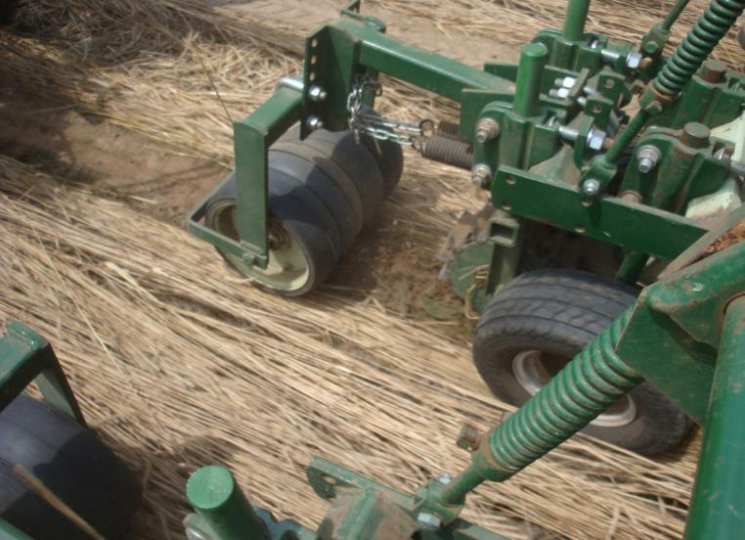
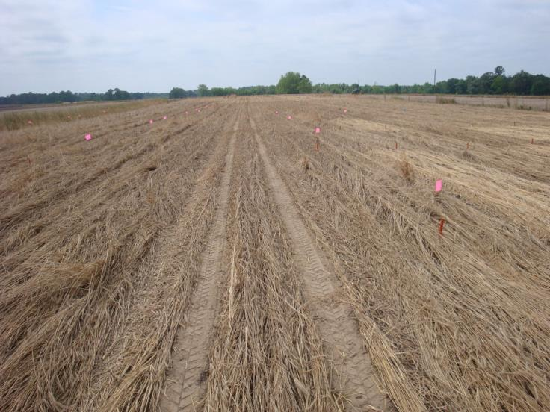
Methods For Rye Process
25 extra units of N in rye program

Slide 23
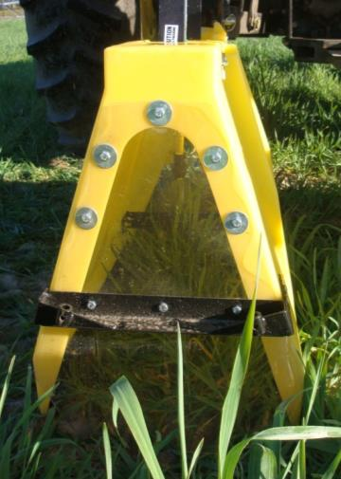
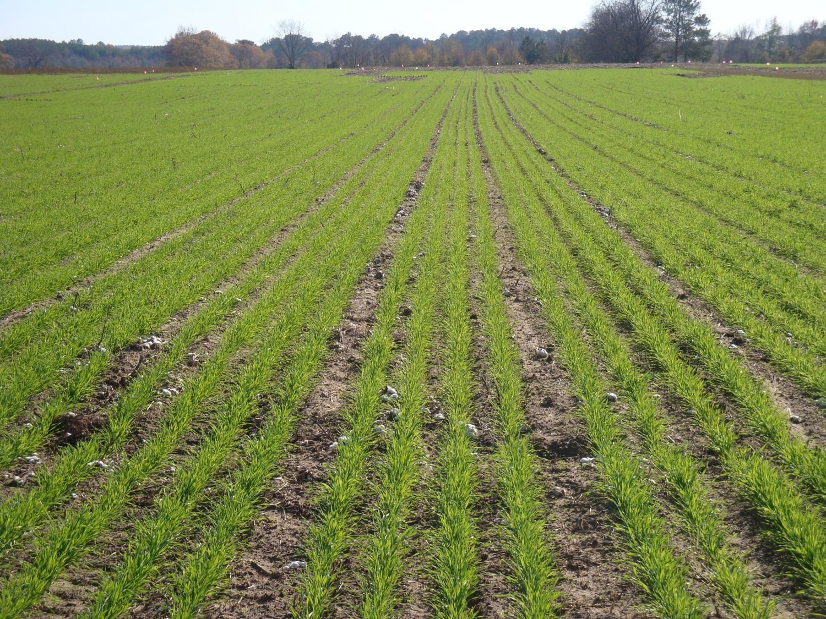

Slide 24
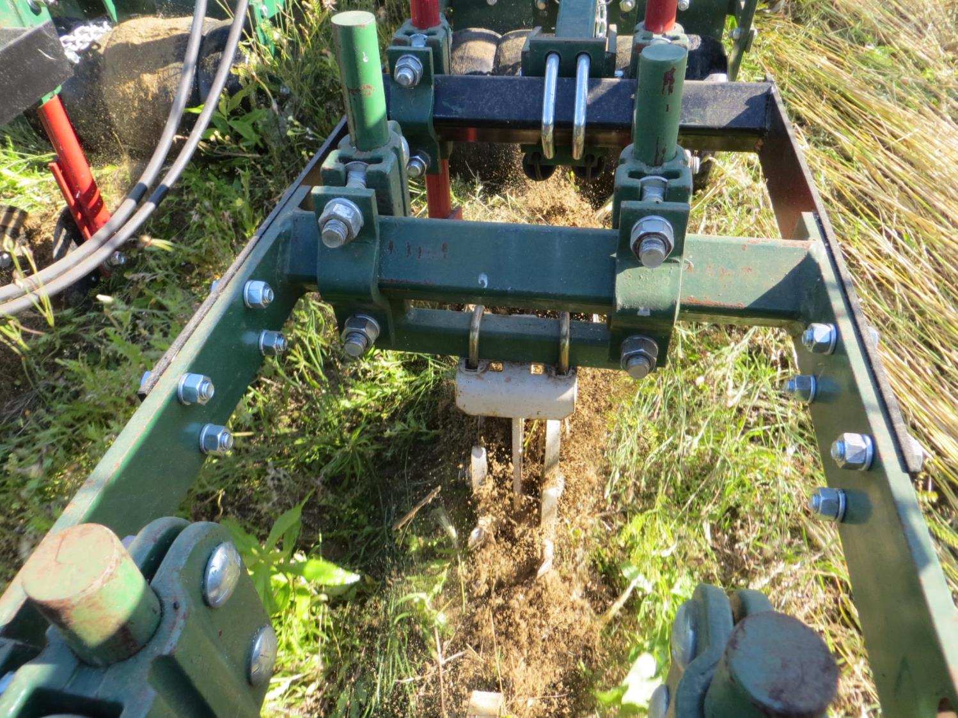

Slide 25
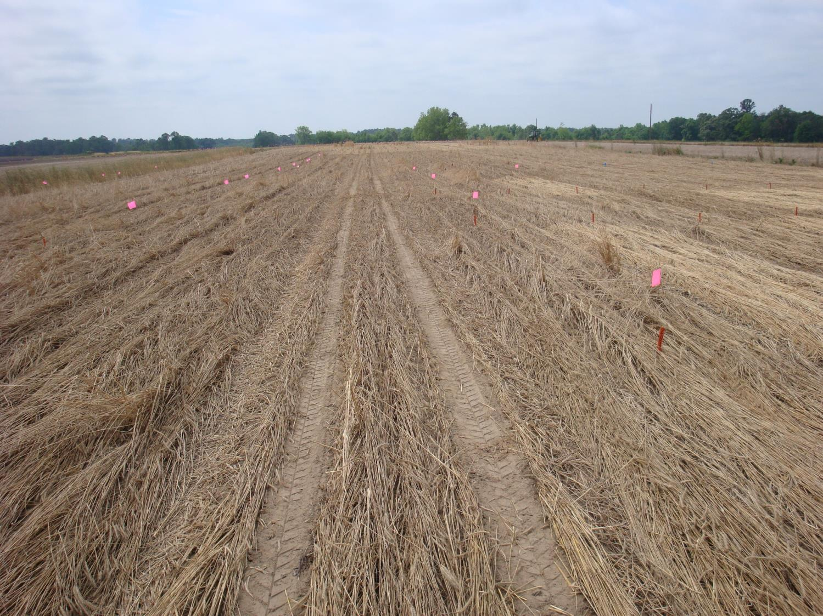
Notes:
Cotton planted into 7500 lb dry ry biomass

Slide 26
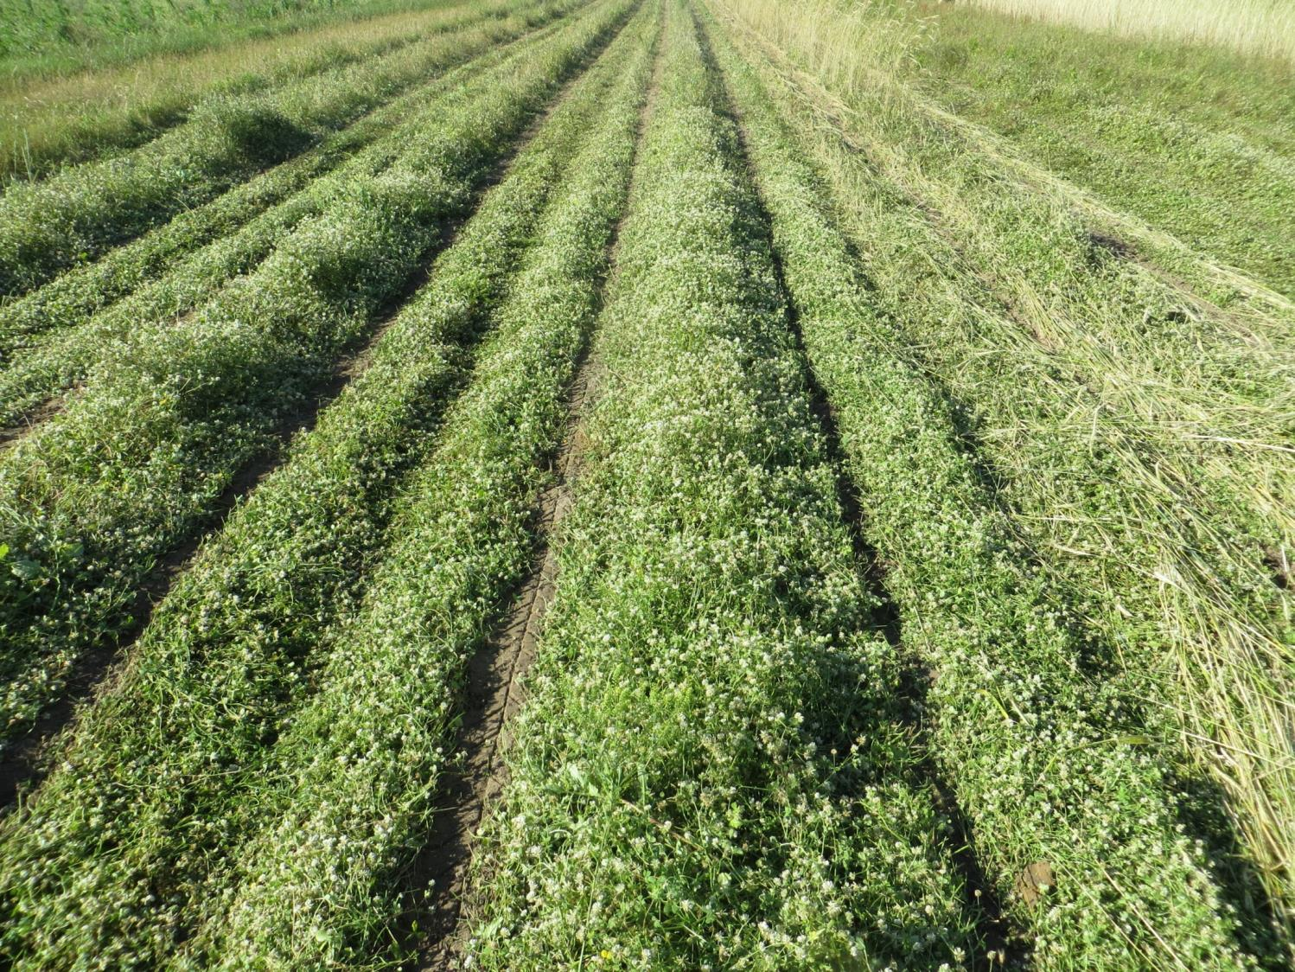

Slide 27
Dry Biomass LB/A AT Planting. 2016 Expo.
Plots 18 feet by 450
12164 a
12502
a
9977 bc
7720c
Rye
90 lb
Clover
12 lb
Blend
R30 + C12
Blend
R90 + C12
Study maintained weed free with timely herbicide program.

Slide 28
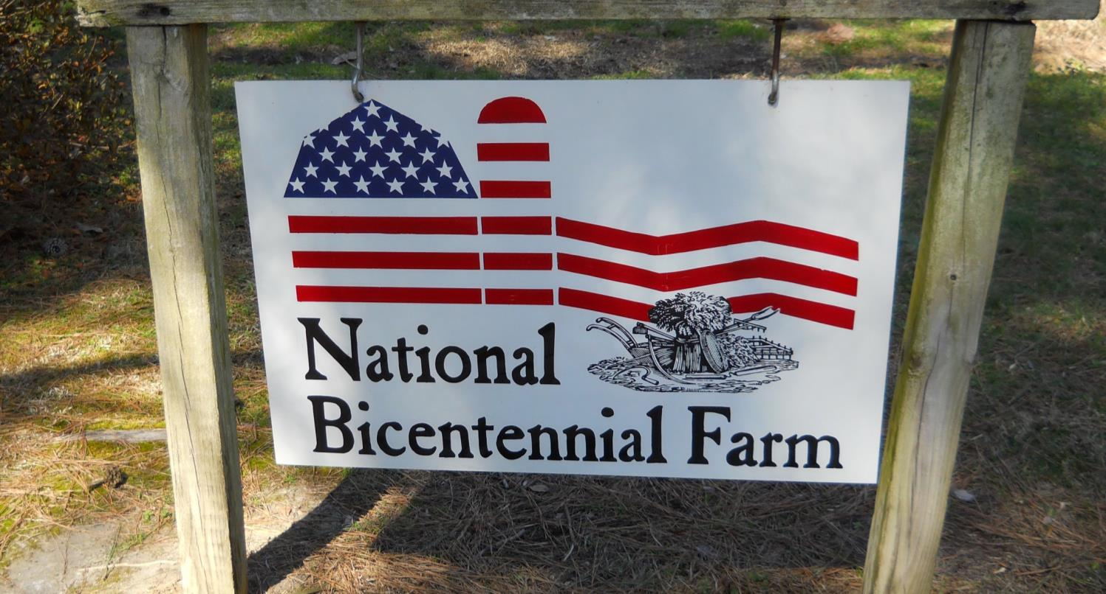
Stanley Culpepper
UGA Extension
Tifton, GA

